Slide 1
Seashell Active
Commitment to Inclusion
CADS Holiday Events
Inclusivity by design

Slide 2
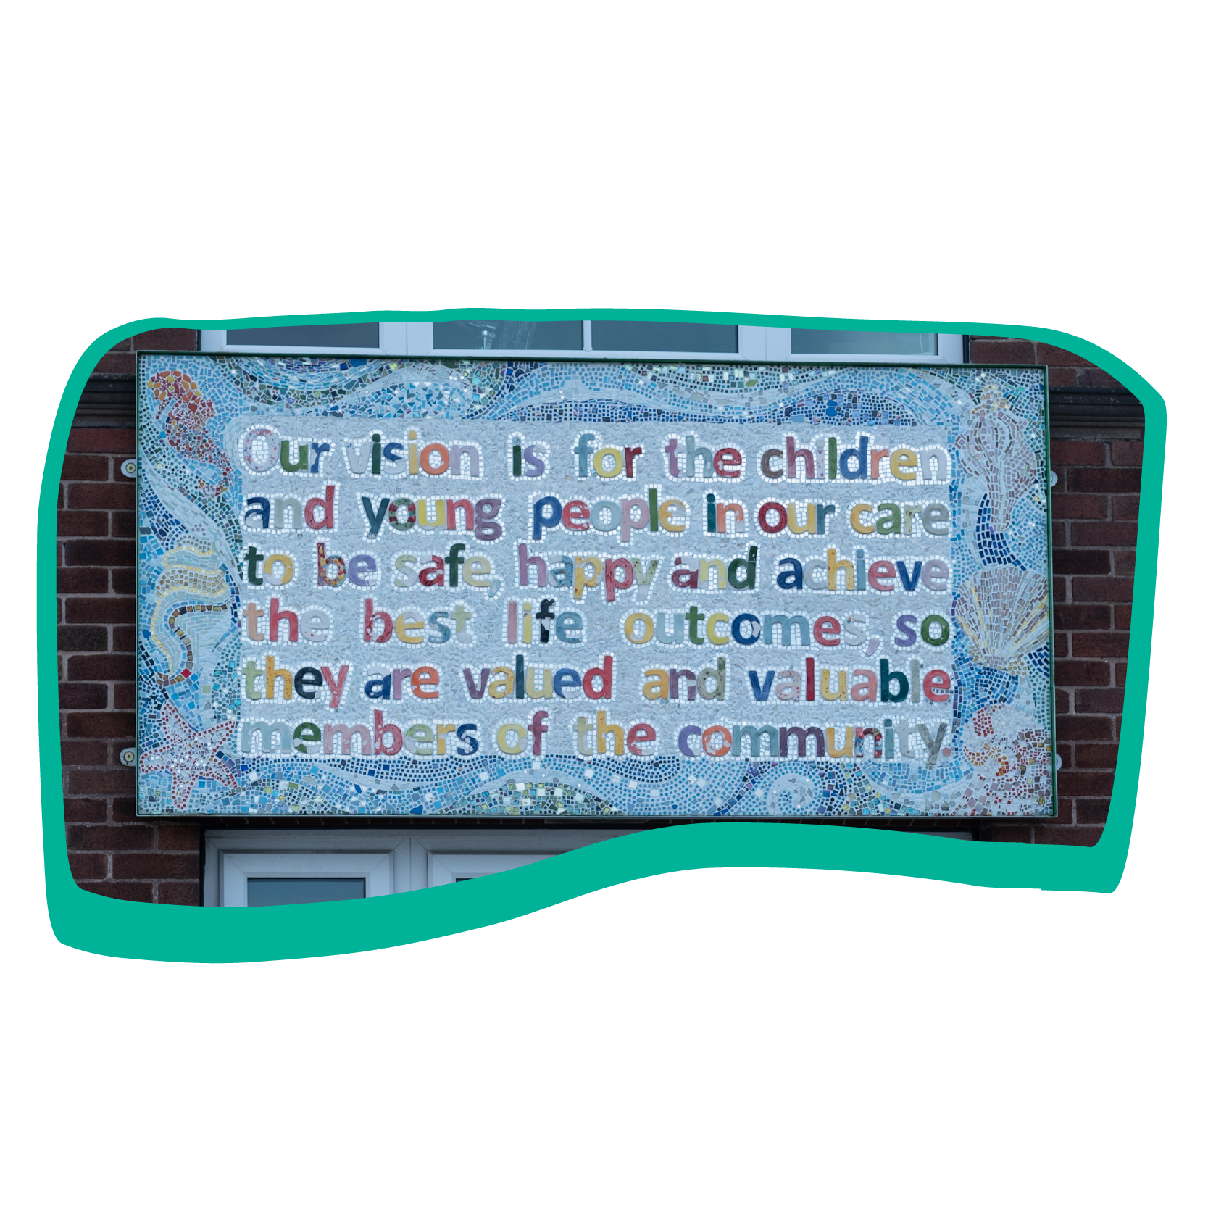
An extraordinary place for extraordinary people
Seashell
Non-maintained specialist school, college and residential provision
National Learning Disability Charity
Provide education, care, support for people aged 2 to 25 years old
Expertise in our specialist Teachers, Care Staff, Therapy and Nursing Teams, Assistive Technology and Seashell Active Coaches.

Slide 3
Seashell Active
Seashell Active staff work with Seashell Education, Care and Therapy teams at Seashell to promote health and wellbeing to all students and residents and provide opportunities to be active.
Working together, each activity is made inclusive from a person centred perspective by first understanding the students needs and enabling access to the activity.
By working together, the staff assist each student to be active and to improve their health and wellbeing. Staff are able to support being active, can communicate and educate the student in learning a skill, to enjoy being active, track developmental goals, assist with gross motor and fine motor skills development.

Slide 4
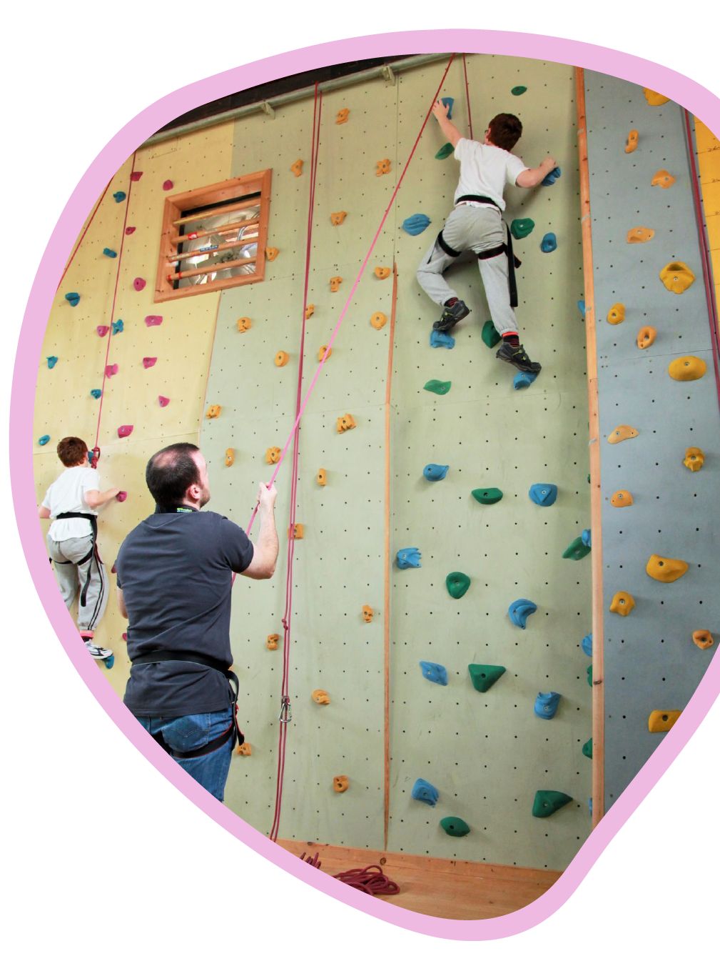
Seashell Active
Our offer is:
Swimming
Hydro Therapy
Cycling
Fitness and Yoga
Climbing
Rebound Therapy
Football
Cricket
Multisports
Seashell Active extends the offer and to communities outside of school and college hours delivering evenings, weekends and school holidays.

Slide 5
Activity Framework At Seashell because of the complex learning needs of our students, our staff have developed activity frameworks for the delivery, teaching and coaching of an activity. We look at the lowest level of accreditation or achievement in an activity offered by an NGB in a sport or physical activity and reduce it even further so that every person can achieve, develop their skill and ability to be active within that sport and celebrate their achievements. From September 2022 Seashell Active are piloting these frameworks in Swimming, Climbing, Cycling and Fitness. Working with NGB’s we share the learning and insight with them, backed up by evidence so the learning can be shared to enable the inclusion of more people with complex learning needs to be active, take part in an activity, progress and develop in that sport or activity and achieve.

Slide 6
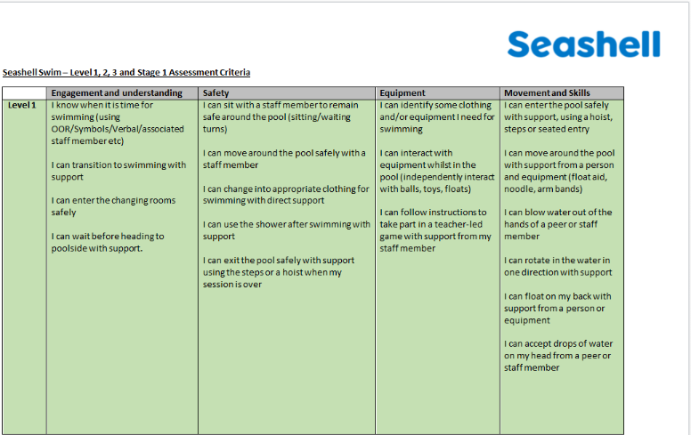
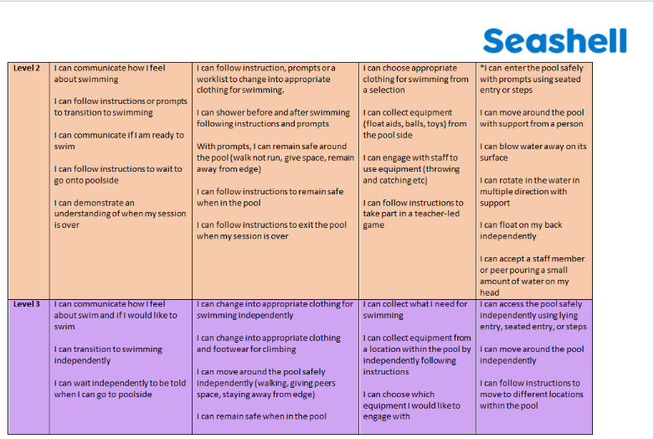
All of that knowledge and learning is applied into our community health and wellbeing offer delivered by Seashell Active. Seashell Active’s commitment to inclusion is to provide person centred inclusion and access to activities.

Slide 7
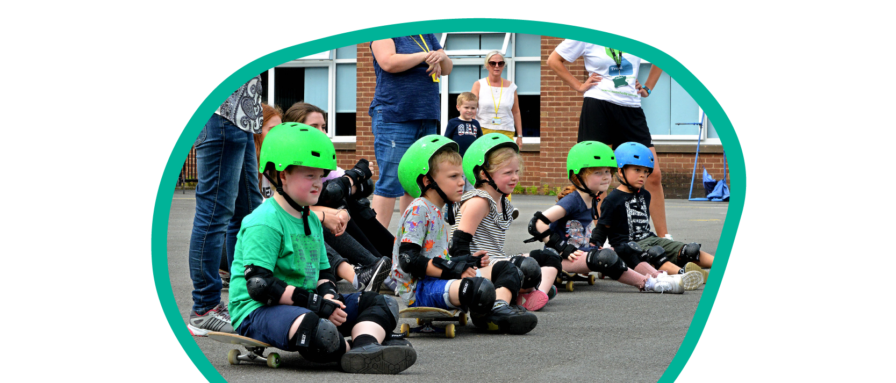
How it all began…
CADS started out in 2003 and was first designed for our students and residents to access a sport and physical activity in the community alongside children and young people who did not have a disability or additional need.
It was very much a grass roots idea and started out with 300 children and young people over a week with a low percentage of people with a disability or additional need but inclusive for everyone to take part at their level or ability. It started out with funding from Sport England.

Slide 8
This has changed over time as the need and demand for this provision grew, especially from families whose children had high complex and medical needs.
Different funding came into the programme from Stockport Short Breaks and Aiming High Funding. The provision became part of Stockport's Offer for families who were going into and were in crisis, who required an inclusive provision and respite during school holidays.
We have tried 4 days of activity, various amounts of children and groups, sometimes up to 80 children or more per event.
Now we deliver CADS for 40 or 50 children or young people due to the amount of high and complex needs that are requesting this provision. There are few providers who deliver school holiday events, with the offer of 1:1 staff support, for high and complex needs children and young people.

Slide 9
Seashell CADS School Holiday Health and Wellbeing Events
What is key to the success of running these events:
Routine – 2 day events, 10am to 3pm
Structure – Groups are no bigger than 12 people and age appropriate, 4 activities with lunch per day
Consistency – 2 team leaders, communication, person centred support, healthcare support needs are planned for and met
Seashell CADS has changed some of its policies and undergone a review due to the high demand from children and young people with complex needs.
Seashell CADS has developed an admissions process to ensure we are able to meet the needs of children and young people. We gather the essential information to be able to make an informed decisions.

Slide 10
We do a lot to understand each person’s access requirements to attend CADS, we do meet and greets at Seashell and provide all the information to parents and carers.
We understand the importance of building confidence with Parents and Carers to give them peace of mind that their child will be safe, included and cared for and ultimately meet the needs of their child.
With every person we meet and provide person centred inclusion and access to activity to, we learn and adapt our approach to communicate with people that we can be trusted as a provider of activity and adapt our resources accordingly.
When parents or carers access provision that is inclusive of need, it can be a relief to those parents carers whose child or young person has complex needs and often describe your provision as a lifeline and are very loyal to your provision.

Slide 11
Specialist Onboarding
An enquiry can come into the team from anywhere for somebody wanting to access the offer.
Seashell Active has a process using ‘Legend’ to gather information about a child or young person and develop a user profile with associated documents.
It takes time for people to register on ‘Legend’ to begin with, however once a profile is created the end user can select the activity option they would like to apply for or to book on to that activity.
‘Legend’ Parent Portal

Slide 12
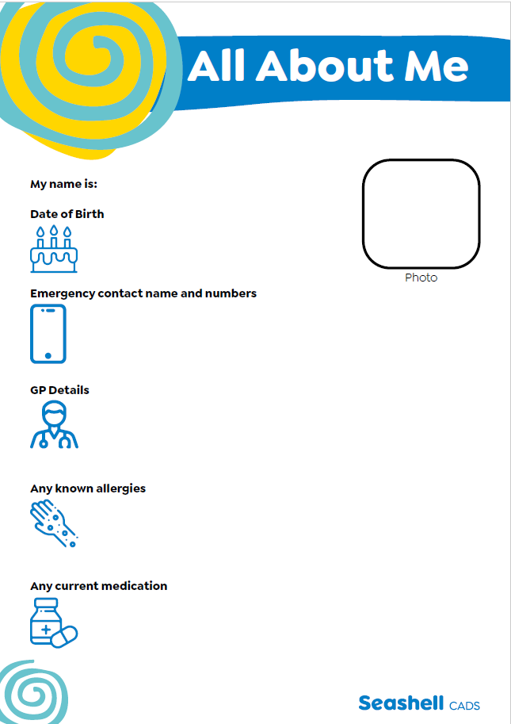
Once the information is gathered about the child or young person (for example, EHCP Plan, SEN Statement, Behaviour Support plan, Medical care plan, report from Occupational Therapy or Physio) a Multidisciplinary Team meeting is held as part of the admissions criteria.
Within the Multidisciplinary Team is a Positive Behaviour coach, Nurse and a member of the Health Team at Seashell.
From that meeting a conditional offer is made to
families.
There could be a meet and greet for families new to Seashell. A log book is created about that child and the relevant information cascaded to the necessary people involved in delivering the CADS event.
CADS Log Book

Slide 13
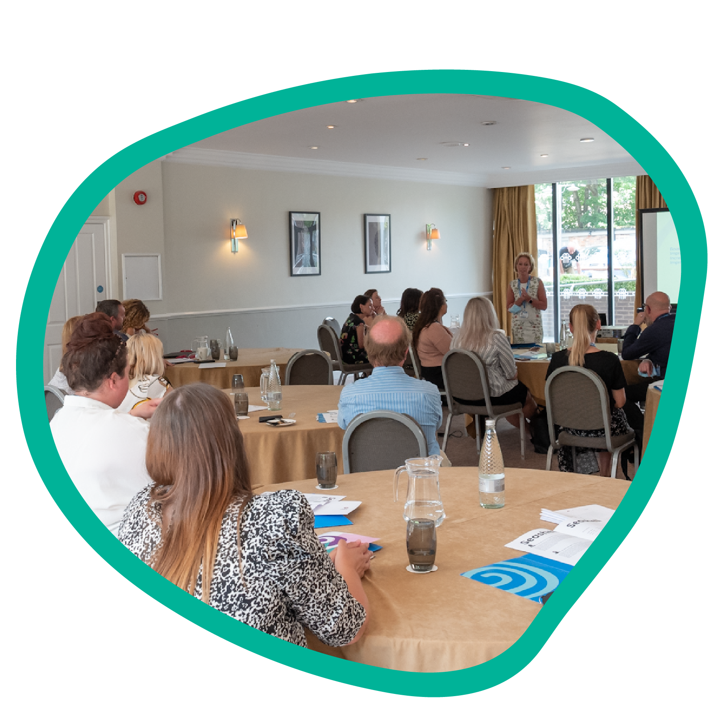
Workforce Development
Every member of Seashell staff attends a week long induction and for staff that work directly with our students or residents they undertake a specialist (contact) induction pathway.
Seashell recruit and employ ‘CADS Crew’ members who are ‘Contact’ staff and receive 2 days induction training and training once a month from our Learning and Development team. These are casual staff members.
Seashell staff from Education and Care choose to do overtime at our CADS health and wellbeing events and we combine those with our own CADS Crew workforce to work on the CADS health and wellbeing events.

Slide 14
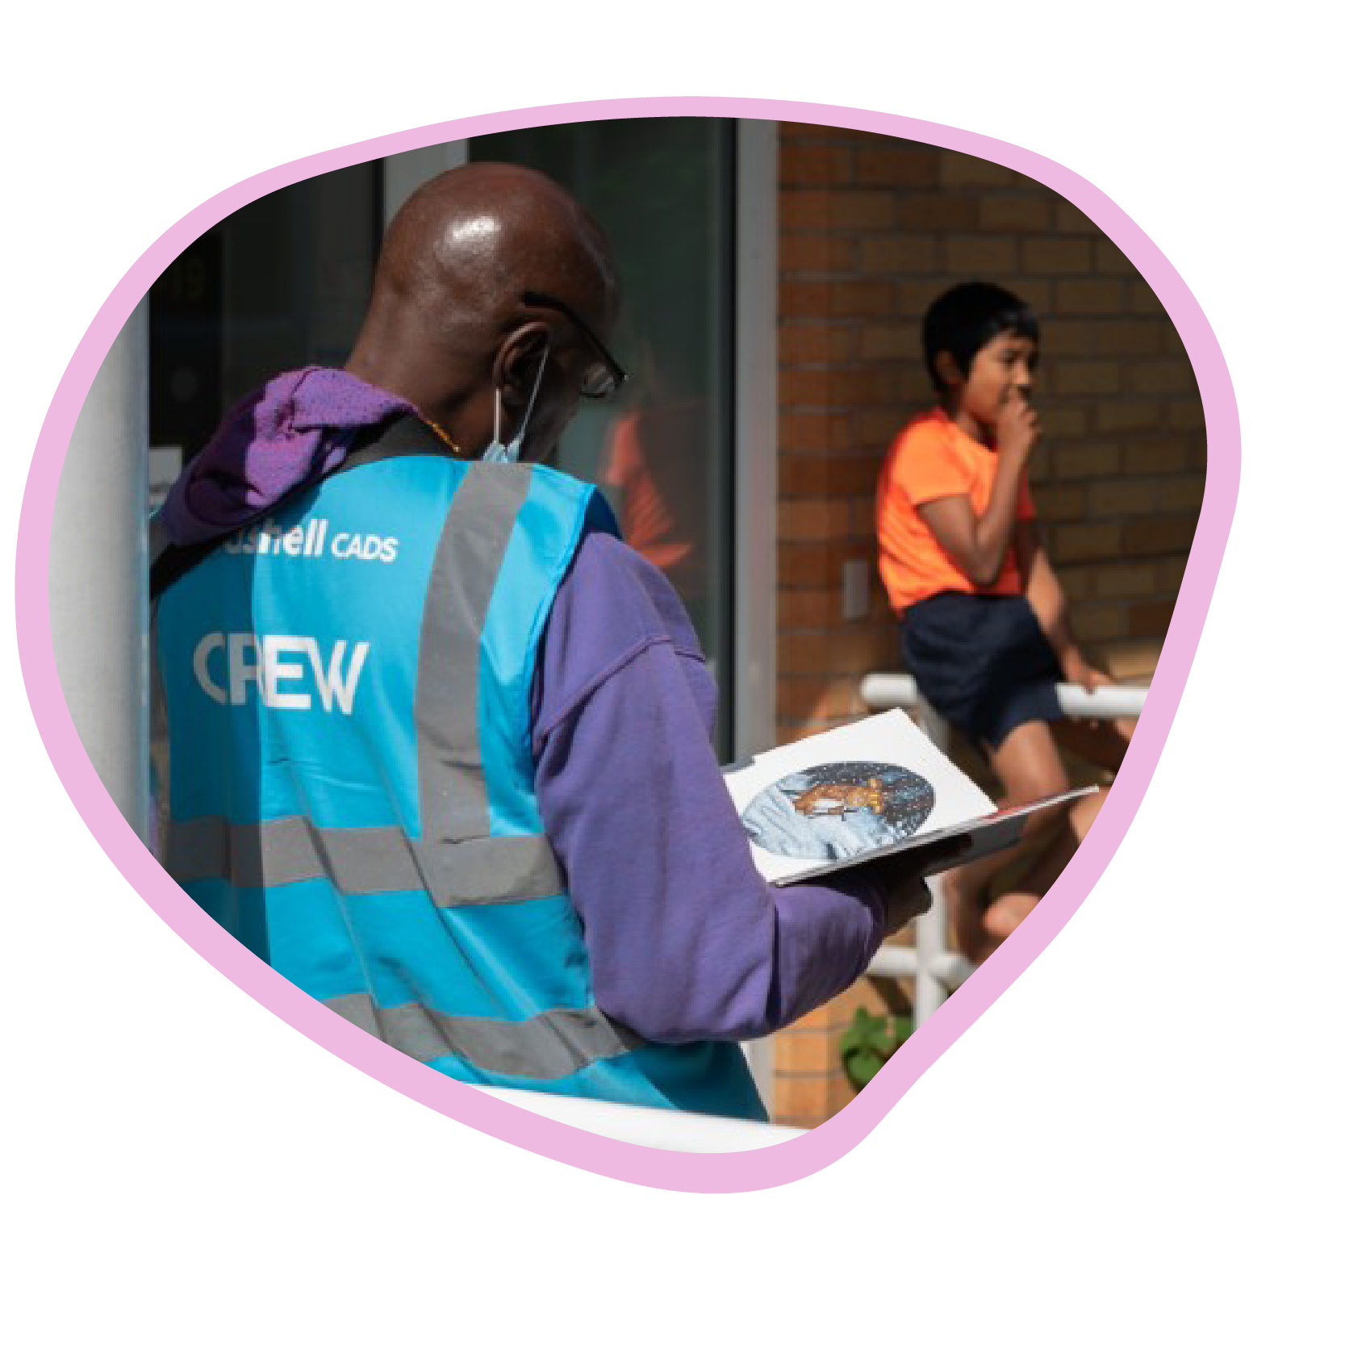
The decision for developing the ‘CADS Crew’ workforce came from years of experience and working with a range of agencies.
It is high risk and extra work to recruit somebody from an agency, you may not always get the quality worker you are looking for that can not only support and care for a child or young person with complex needs but that can build rapport easily and ‘activate activity’ providing active support.
During our CADS event, our staff role model active support, we invest in our CADS Crew workforce by delivering additional training once a month.

Slide 15
Inclusivity by design
Before each event, we communicate essential information to parents and carers, staff and coaches to inform them about the CADS Health and Wellbeing events and to reduce any anxieties or concerns people may have. Parents and Carers need this information to help prepare their child to be active and attend the event.
We provide briefings at the beginning of each event and a debrief at the end of the day for all of our staff.
We give time and space for parents and carers to ‘Sign in’ their child or young person and tell us anything that we might need to know about or may have happened recently could impact on the behavior of a child or young person at CADS. Upon pick up, we do the same, we relay information about the child or young persons day to the parent or carer as often the children and young people are unable to communicate what happened during the day.

Slide 16
Set up a nursing station for the signing in of medication and checking medical care plans etc.
Staffing - we have a CADS coordinator, 2 team leaders per group, support staff and volunteers.
DBS checks for agency staff are carried out. We provide them with a briefing about the event and require them to read the log book of the child they are supporting that day.
We have a volunteer coordinator who briefs the volunteers about the day and support across the day who help as ‘activity activators’
The cost of the provision is £85 for 2 days or £45 for one day. The cost for a one to one support worker can be up to £123 per day. Direct Payments or LEA or Social Workers pay the cost of one2one and Seashell has a private donor.

Slide 17
By Committing to inclusion
As a provider you Increase your ability to include children and young people with high / complex needs into your provision and that benefits everyone.
The relationships you build with the family, parents / carers, children and young people becomes close, you become a key part of their life and involved in the development of their child. Not only during school holidays but in other provisions such as learning to swim, ride a bike, kick a football, make a friend and more.
As a provider you gain a positive reputation and the community see and feel your values of inclusion, they see you as an ally or SEND friendly.
Your positive engagement will lead to co-produce and design new programmes and offers for this community increase as will your ability to secure funding to meet the needs of the community.

Slide 18
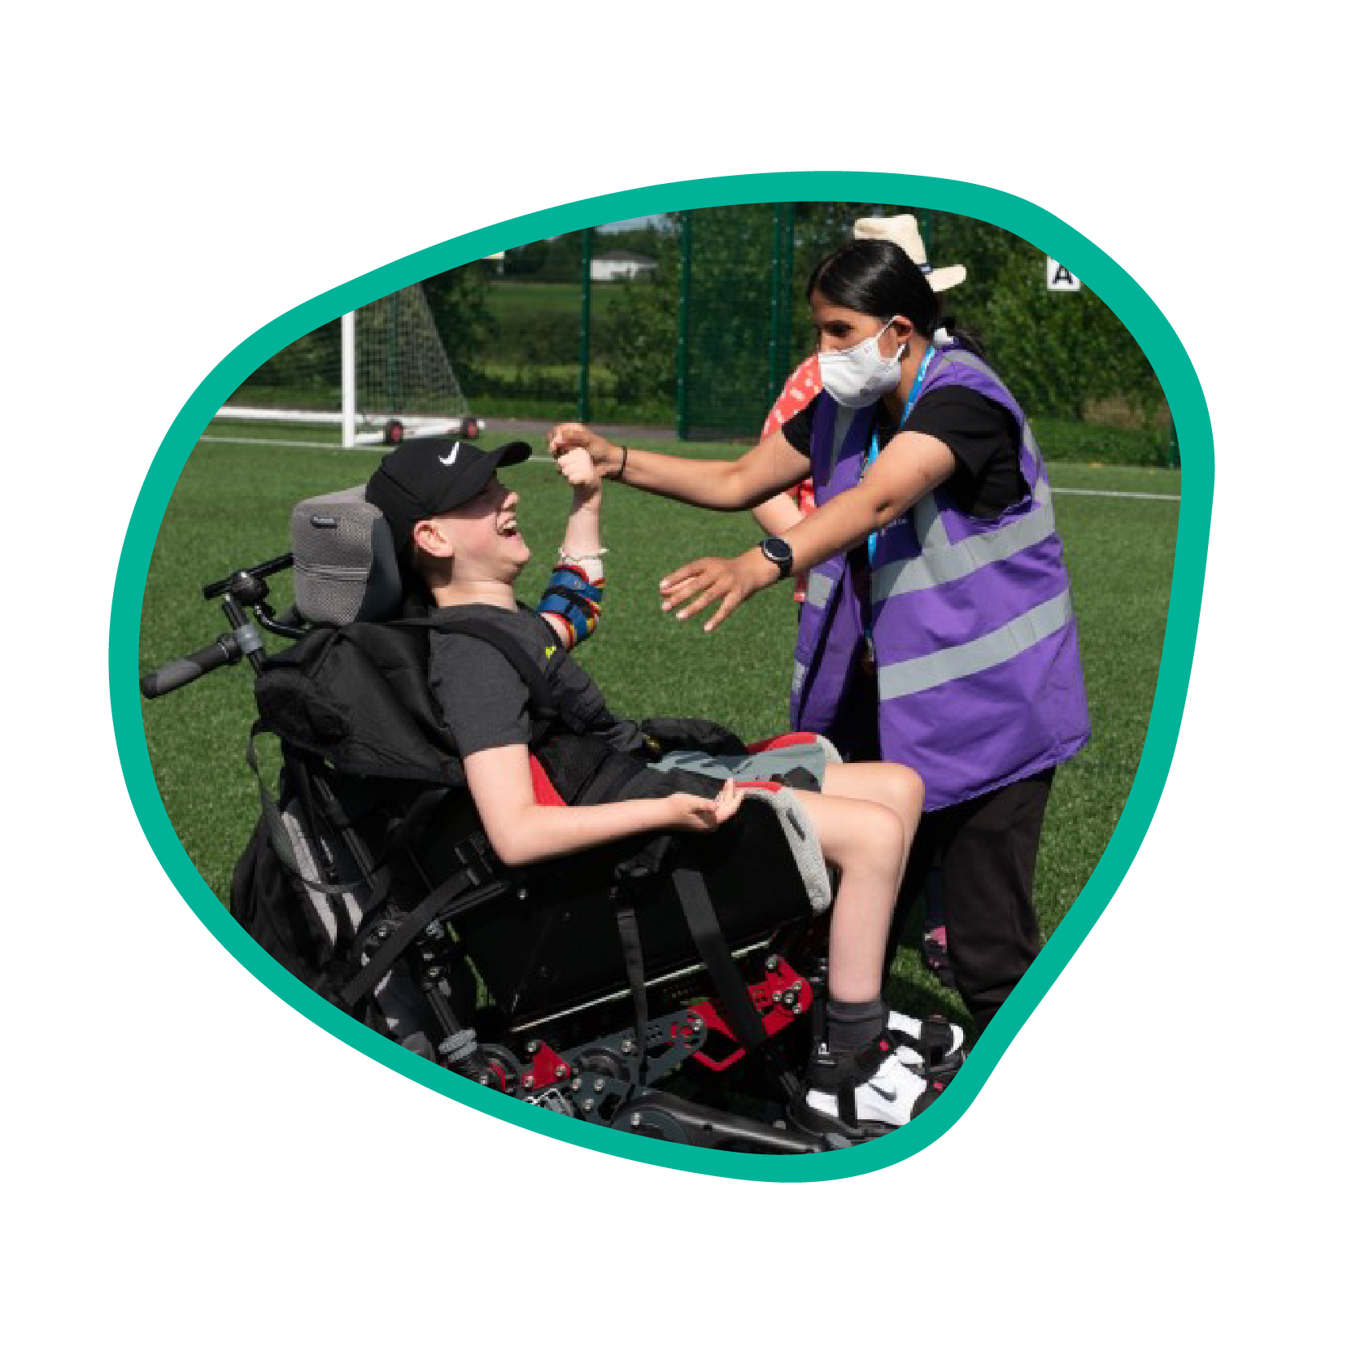
By including a child with high/complex needs within your provision, meeting their needs and building positive associations with them will lead to early intervention, progression and development.
This is how activity can become part of a social norm for high / complex needs children and young people, when the person is supported, enabled and empowered to do so.
A person with high / complex needs included as part of their community and to be active benefits whole families, parents, carers and siblings.

Slide 19
Achieving inclusion within your offer for complex and high needs children and young people can be done.
It takes extra work but there are long term positive impacts on the children and young people that are supported to be active, enjoy sport, progress and achieve.
Getting the right staff is important, it is very rewarding helping people and supporting them to be active. We can all learn from one another and be ambassadors for inclusion.
Thank you.
For more information please contact: Gemma.Lynch@seashelltrust.org.uk

